Slide 1

Year 1 and 2 parent meeting
Miss Neary

Slide 2

Prayer
Dear Lord,
As we prepare for the coming of a new academic year, make us ready, attentive and available to hear you. Thank You for the gift of being able to wake each day with the assurance that You walk through it with us. Thank You for the gifts of creativity and uniqueness, and the energy to put them to good use.
Amen

Slide 3
The Year 1 and 2 Team
Mrs Neary – Year 1 and 2 Class Teacher
Mrs Crowley – Teaching Assistant
Mrs Lang 1:1 LSA
Mrs Obi 1:1 LSA
Mrs Stevens 1:1LSA

Slide 4
The Routine
8.30am soft start in the classroom
8.45 school gates close and registration
Core teaching of maths, phonics, English and RE
Playtime 10.30 – 10.45am
Lunch time 12.00 - 1.15
Afternoon teaching sessions (foundation subjects: history / geography/art/DT/science)
3.15pm home time

Slide 5


Reading and Phonics
The children will take part in daily phonics sessions led by Miss Neary and Mrs Crowley. In the first few weeks we are focusing on recapping and reviewing the sounds the children have previously learnt. We will continue to use the Little Wandle phonics scheme for Year 1 and the Spelling shed scheme for Year 2.
Handwriting – Year 1 will be learning how to use pre-cursive letter formation which is the foundations of learning how to join.
Handwriting – Year 2 – are continuing to develop their use of joined writing particularly when they are writing independently. By the end of Year 2 the children should be able to fluently join in their writing. We follow the Letter join scheme.
Reading – the children are heard at least three times a week by one of the adults in the Year 1 and 2 team in their group reading sessions. Children should be heard at home on a daily basis and books should be read more than once to encourage fluency and word sight familiarity. Books must be returned on the specified day – see curriculum letter

Slide 6
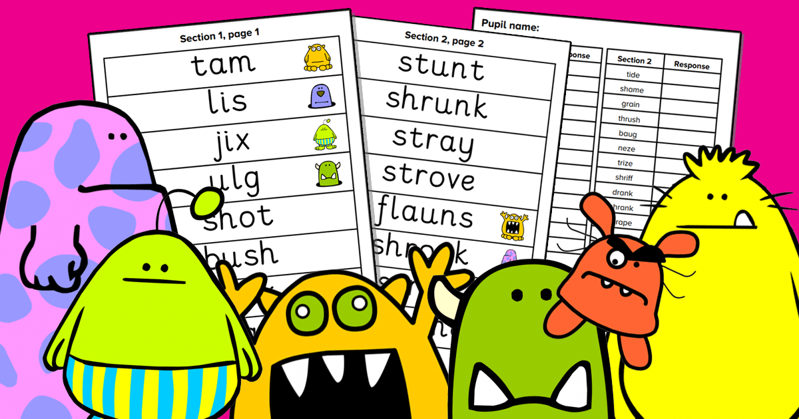
Phonics screening for Year 1
The children will be taught a series of sounds over this academic year is the sequence outlined. It is expected that they can use these sounds to decode both ‘real’ and ‘nonsense’ words.
The phonics screening will take place in June and you will be notified in your child’s summer report whether they have passed or not. In the case that they do not, they will re do the assessment in Year 2
Around Easter we will send home materials to practise with.

Slide 7

Maths
We use the White Rose scheme of learning from Nursery up to Year 6
There is a parent section with useful videos, top tips and workbooks you
can purchase at home to support your child’s learning
Multiplication:
Year 1 – should be able to count in 2s 5s and 10s
Year 2 – should secure the effective recall of the 2, 5 and 10 times tables
See the school website for a range of resources to support this at home.

Slide 8
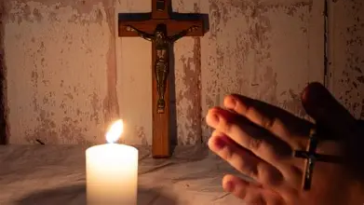
RE and Liturgy
Monday – New Week Assembly (gospel teaching focus)
Tuesday – class act of worship
Wednesday – Wednesday word with chaplaincy team
Thursday – Singing Worship
Friday – Key Stage Act of Worship led by Mrs Overett / Miss Neary
RE lessons are taught 2 x per week focussed on a more creative approach in one lesson and a written reflection or scripture - based session for the second

Slide 9

Home learning is very important for children to embed and consolidate learning from class teaching.
Each half term, a grid of 6 cross curricular activities are set for the children to complete. They should complete one activity per week. This can either be uploaded to tapestry or can be brought in for our class home learning display. Each of the activities are linked to topics we are learning about in class.
Year 2 should begin weekly times tables practice (you will be communicated when this should begin and how)
Spellings – weekly spelling sheets will be given out on a Monday and will be tested the following week. Please keep these sheets at home for the children to use to practice and apply. They should be looked at daily across the week. If your child finds it difficult to learn all 10 spellings, please focus on the top 5 or 6. Spellings are matched very closely to the phonics learning for that week. Note – spelling tests vary and will be done in a variety of ways and days)

Slide 10


PE and Forest School
PE will take place on Friday with our new Sport Coach – Mr Kitteridge
They should have a named PE kit in school from Monday – Friday as they will have a second PE lesson taught by Mrs Neary. These will come home each weekend for washing.
You will be notified of Forest School sessions next academic year for Year 1 and 2.

Slide 11

Year 2 SATs and Assessment
Although year 2 SATs are no longer statutory requirement, Year 2 still take part in the assessments during the summer term in line with all other St Francis of Assisi Trust.
We will use SATs to prepare for using them in Year 3.

Slide 12
What to bring…
Ideally a St Thomas’ rucksack or book bag (size limitation!)
No pencil cases required (although donations of colouring pens, pencils, glue sticks are always much appreciated throughout the year!)
Hats
A named water bottle daily
Transition period for the new school uniform until September 2026
PE kits in a small named bag

