Slide 1

Year 3/4
(Mrs S Gilbert)
Meet the teacher

Slide 2
Staffing
Mrs Gilbert – Class teacher – Monday, Tuesday (am), Wednesday, Thursday and Friday (am)
Mrs Stevens – Teaching Assistant - full time across the week
Mrs Pettitt – Learning Support Assistant

Slide 3
General information…
When children move into Year 3 they become part of KS2 (a junior)
In Year 3 and 4 there is an increased focus on spelling, we develop a wider range of writing skills and have a heavier focus on learning times tables in maths.
The children get taught a wide range of subjects including RE, history, geography, science, art, design and technology, computing, PE, PSHE and French. Our timetable is jam packed!
Don’t be surprised if your child seems tired, especially moving from Year 2 to Year 3. They have been working hard and adjusting to new expectations.
Year 3 will need to move Key Stage 2 uniform – shirts and ties from October half term– for boys and girls are welcome to wear open collared blouses or shirts and ties.

Slide 4


We usually do PE on Wednesday and Friday but please ensure PE kit is in school everyday.
Trainers should be in school at all times. We participate in the Daily Mile when we can. This is where the children run/jog for around 15 minutes during the school day. The aim of the Daily Mile is to improve the physical, social, emotional and mental health and wellbeing of the children.
PE kit
In Key Stage 2 the children need:
Either the previous PE kit
Or navy short, and the new PE top with a navy tracksuit (as per the previous correspondence)
They also need trainers. Astro boots are also useful. No studs please.

Slide 5

Homework
Weekly homework will be set on a Thursday and is due in by the following Thursday unless otherwise specified Weekly homework will usually have a maths or english focus, occasionally there will be a second wider curriculum piece.
Homework will be set on the Seesaw platform but I may send worksheets home to be completed.
Each week the children will have a list of spellings to learn. Spelling tests usually take place on a Friday morning.
Reading and times tables practice should be frequent throughout the week.

Slide 6

Learning Times Tables
All pupils are expected to know all their multiplication tables off by heart (up to 12x12) by the end of Year 4. Although tables are rehearsed at school, weekly tables practice at home is essential.
There is a national multiplication check in the Summer term of Year 4. The purpose of this check is to determine whether pupils can fluently recall their tables, which is essential for future success in mathematics. It helps to identify pupils who need additional support.
The MTC is an on-screen check consisting of 25 times tables questions. Children have 6 seconds to answer each question. On average the check only lasts 5 minutes.

Slide 7
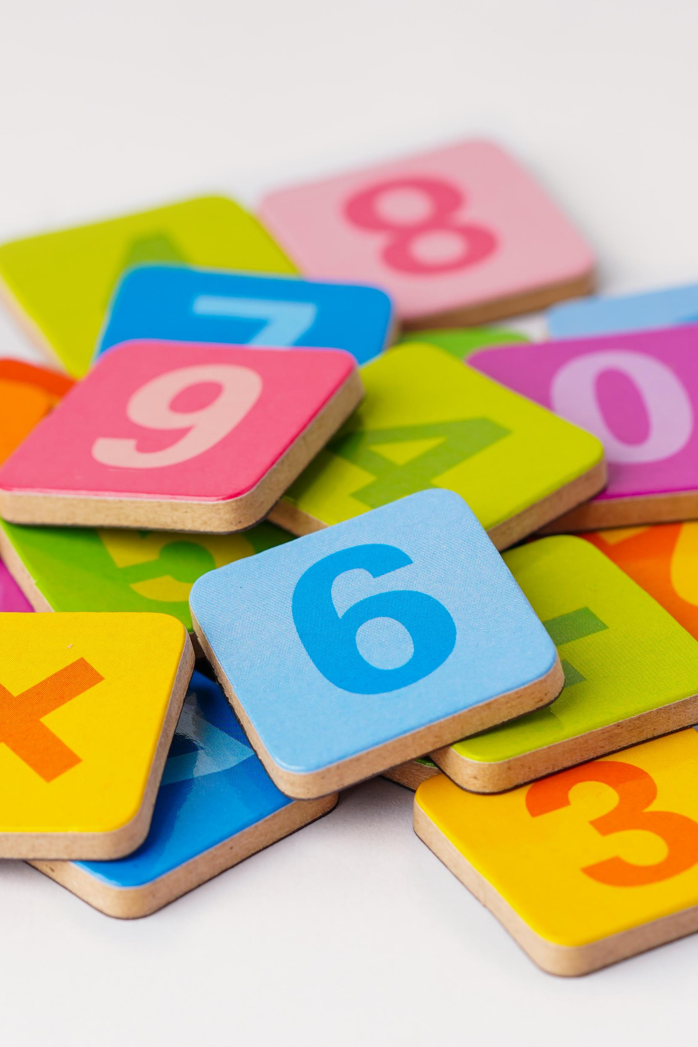
Ways to learn times tables…
You can practice times tables anyway you like at home with your child-try to make it fun!
There are some great tables songs with dance moves free to access on https://www.bbc.co.uk/teach/supermovers/ks2-maths-collection/z7frpg8
Children can play practice games at any time on EdShed
https://fiveminutemum.com/ has brilliant ideas for turning tables practice into fun games!
https://www.playfullearninggames.co.uk/ is another great resource for engaging games to support English and Maths learning.

Slide 8

Reading in KS2
Reading is an essential life skill that empowers children to reach their full potential.
In KS2 we move from the coloured book bands to numbered stages (usually stages 9-15 in Year 3/4)
Children start by reading from Oxford Reading Tree books within the band they have been assessed to be at. They can then move to a parallel selection of books pitched at the same level to further develop stamina and reading for enjoyment (this is usually grey in Year 3 and dark blue in Year 4)
We suggest reading shorter texts three times before they are changed. First time for decoding, second time to develop fluency and the third time for the development of comprehension.
Please hear your child read at home frequently-ideally at least 4 times per week. Any comments can be added to Seesaw.
Reading to your child is still really important in KS2! Reading to your child can give them the opportunity to hear stories and language at a higher level than they may be able to read completely alone.

Slide 9
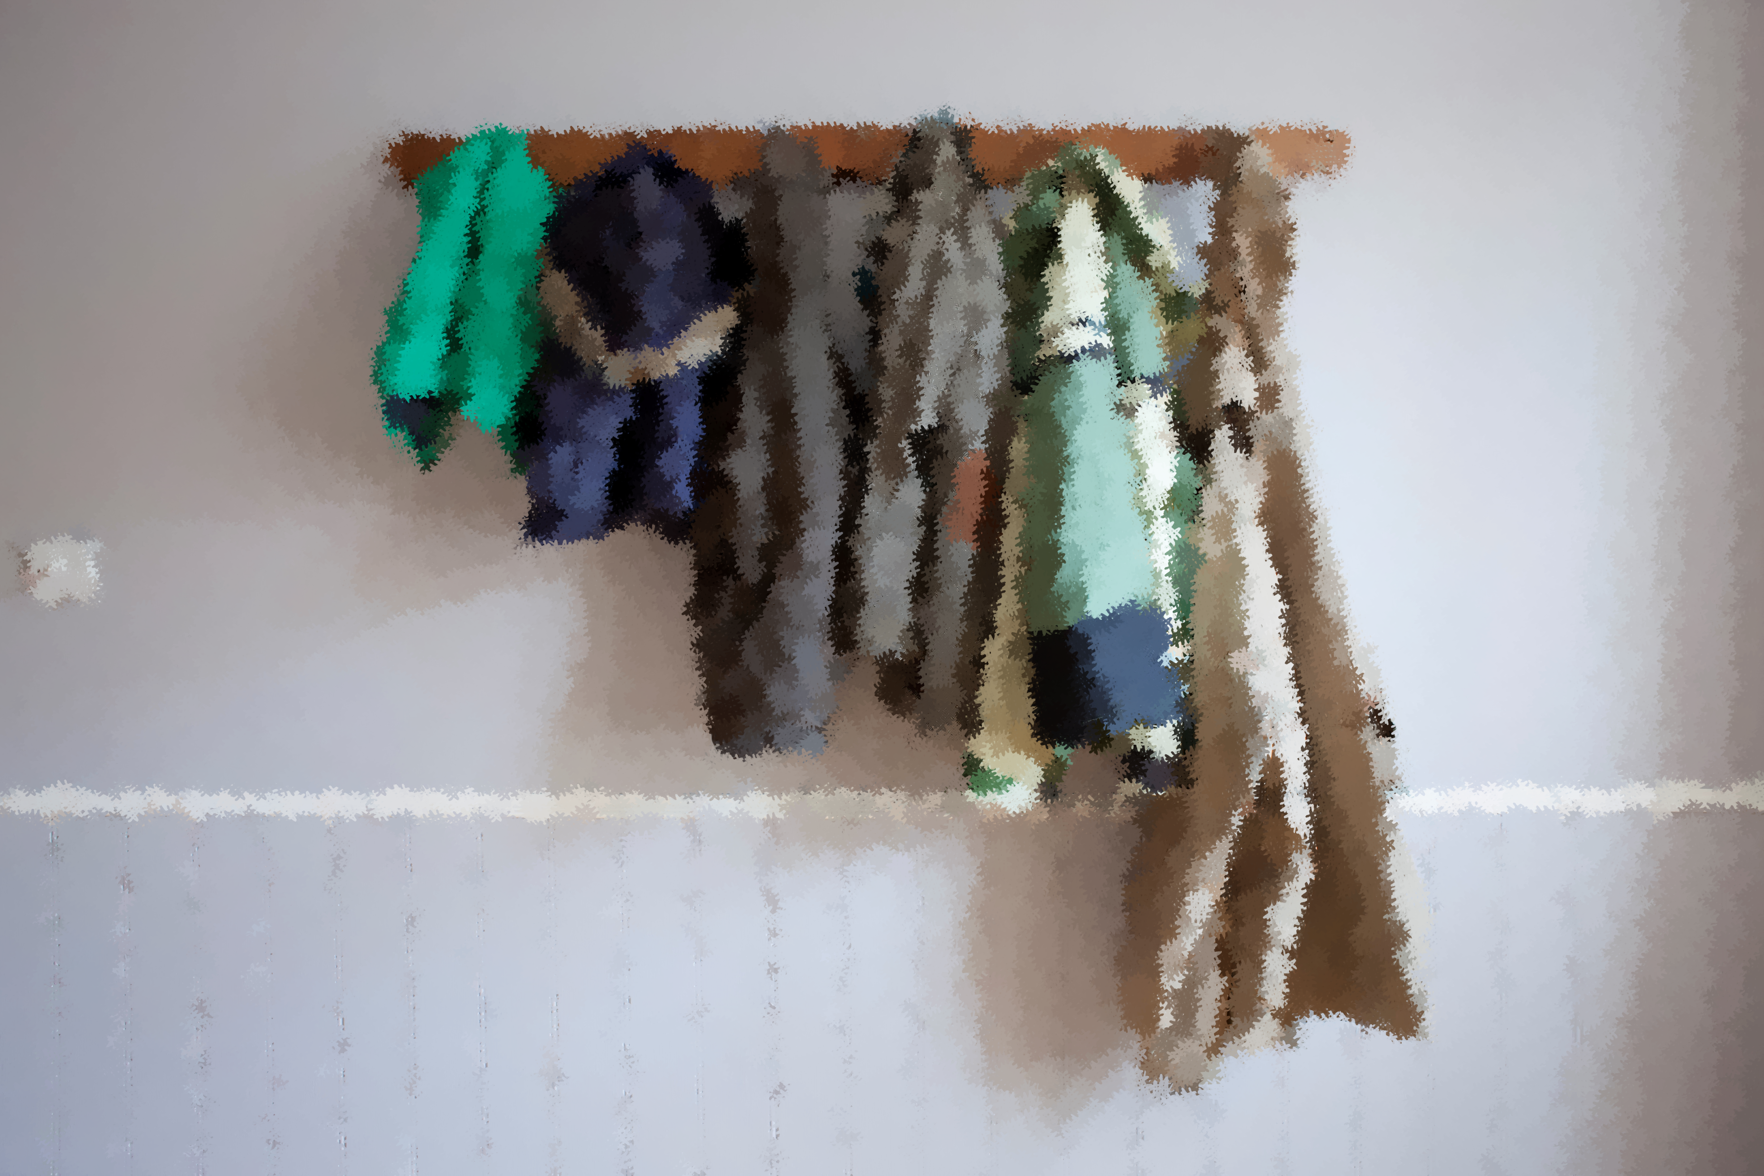
Equipment…
All children in the class have their own stationary pack, but may bring a small pencil case of their own if they wish (it will need to fit into their drawer though)
Please keep school bags small-our cloakroom becomes very congested, particularly once the children have coats etc.
Jewellery reminder-children are permitted to wear stud earrings and a watch. Both must be removed for PE lessons.

Slide 10
A few other things…
Prayer Books
Projects - we will start self-directed learning tasks during the spring term linked to one of our topics
Contact me: mrsgilbert@stcanterbury.herts.sch.uk

Slide 11

Any questions?

