Slide 1







Welcome to Year 5/6
Mrs Clark and Mrs Barrett
SCHOOL YEAR 2025-2026

Slide 2




Staffing
Class teachers: Mrs W Clark (Mon-Wed)
Mrs H Barratt (Thurs-Fri)
HLTA: Mrs Hennessy
Other Adults Supporting: Mrs Obi, Mrs Stevens
Music: Mrs Goode
PE Coach: Mr Kitteridge

Slide 3

Mrs Barratt
About Me:

Slide 4





Equipment
  Labelled PE kit
  Water bottle
  Backpack
  Forest School Clothes (including waterproofs)
  Optional-Small Pencil Case

Slide 5



  More formal learning based on regular lesson patterns with clear structure
  Daily maths and English lessons
  RE 2.5 hours per week
  PE 2 hours per week
Routines

Slide 6
  Occasional separation of year groups
  Year 6 booster work begins at the beginning of October half term.
  Year 5 food technology with Mrs Hennessy.
  SATS week beginning Monday 11th May
  Your child may be invited to attend additional booster sessions after school.
Routines

Slide 7



Homework
Daily reading
Daily practice of spelling lists
Daily practice of times tables aimed at instant recall-
Weekly English and maths tasks to consolidate weekly work in class or grammar, punctuation work
Submission on Seesaw
RE – once per half term
Some project based work
Personal development activities

Slide 8



Administration
  All children will need Seesaw set up on a device (new log in codes will be issued)
  Seesaw will be the main place for weekly updates, homework and general messages
  Other contact via email or phone call

Slide 9
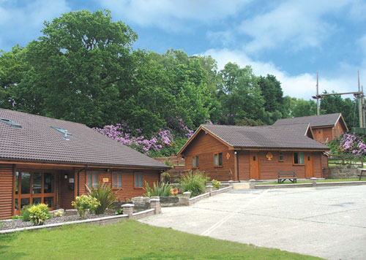
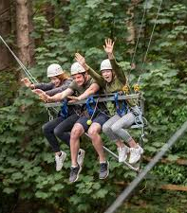
Hilltop Residential 2026
Friday 19th June to Monday 22nd June (over a weekend-this was so we could get a good time of the year, post SATS)
New venue for us, but highly recommended by other Trust schools
Beautiful location in Sheringham, Norfolk
Parent meeting will be scheduled in the Autumn Term-Thursday 4th September at 3:30pm

Slide 10
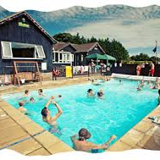
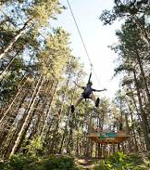

Deposits due by 5th September following the meeting: £81

Slide 11




Here’s to a great school year!
Any questions?

