Slide 1
Key Stage 2
Math Workshop
Mrs Gilbert and Mrs Clark
Year 3 and 4 Year 5 and 6

Slide 2
Has maths changed?
https://whiteroseeducation.com/parent-pupil-resources/maths/maths-with-michael

Slide 3
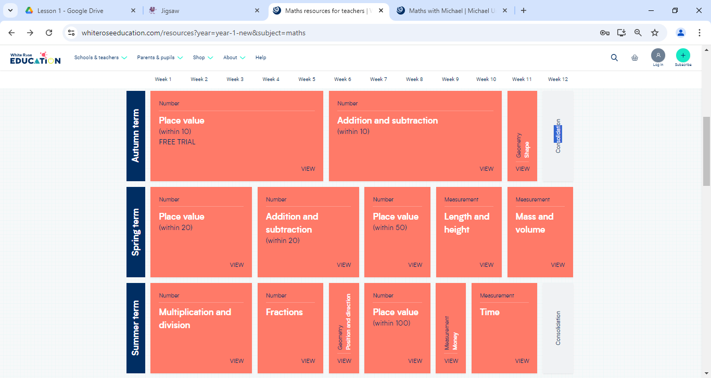
Year 3 example – math learning is broken down into small steps within each block of learning. The purpose of this is for the children to gain a deep understanding of each concept before moving on.

Slide 4
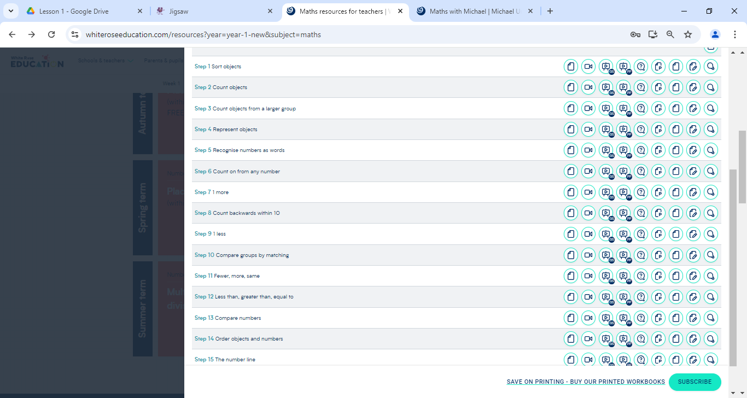
Within each block of learning there are a series of small steps which help build upon the previous one and consolidate learning before moving on.

Slide 5
CPA (Concrete, Pictorial, Abstract)
Children (and adults!) can find maths difficult because it is abstract. The CPA approach builds on children’s existing knowledge by introducing abstract concepts in a concrete and tangible way. It involves moving from concrete materials, to pictorial representations, to abstract symbols and problems.
Concrete
Concrete is the “doing” stage. During this stage, students use concrete objects to model problems. Unlike traditional maths teaching methods where teachers demonstrate how to solve a problem, the CPA approach brings concepts to life by allowing children to experience and handle physical (concrete) objects. With the CPA framework, every abstract concept is first introduced using physical, interactive concrete materials.

Slide 6
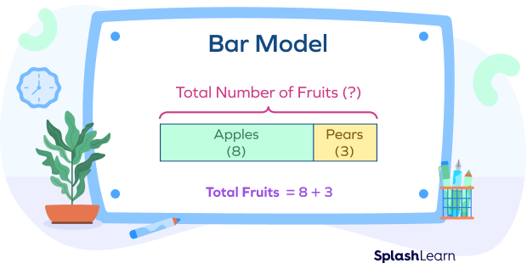
CPA (Concrete, Pictorial, Abstract)
Pictorial
Pictorial is the “seeing” stage. Here, visual representations of concrete objects are used to model problems. This stage encourages children to make a mental connection between the physical object they just handled and the abstract pictures, diagrams or models that represent the objects from the problem.
Building or drawing a model makes it easier for children to grasp difficult abstract concepts (for example, fractions). Simply put, it helps students visualise abstract problems and make them more accessible.

Slide 7

CPA (Concrete, Pictorial, Abstract)
Abstract
Abstract is the “symbolic” stage, where children use abstract symbols to model problems. Students will not progress to this stage until they have demonstrated that they have a solid understanding of the concrete and pictorial stages of the problem. The abstract stage involves the teacher introducing abstract concepts (for example, mathematical symbols). Children are introduced to the concept at a symbolic level, using only numbers, notation, and mathematical symbols (for example, +, –, x, /) to indicate addition, multiplication or division.

Slide 8
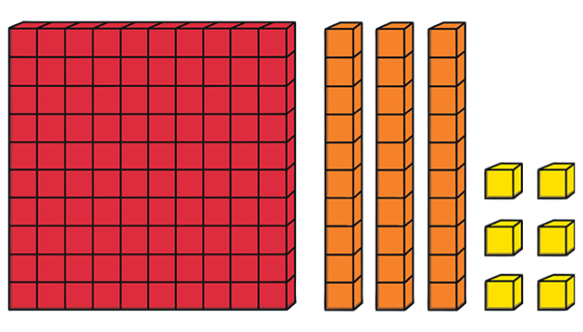
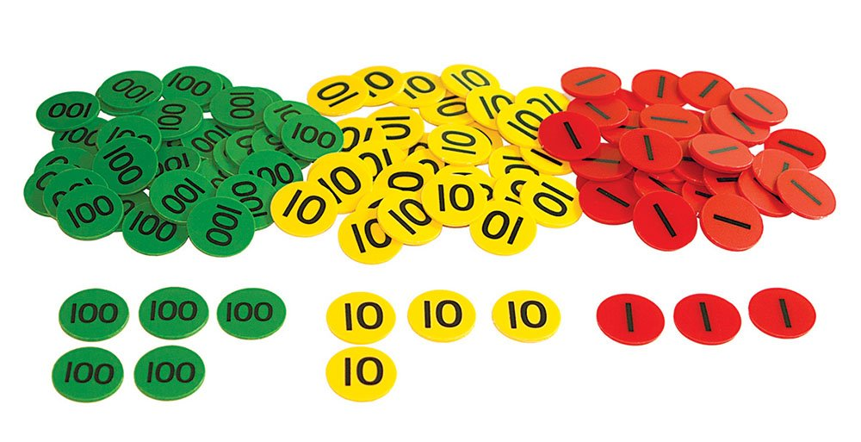
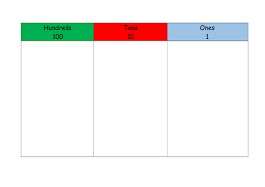
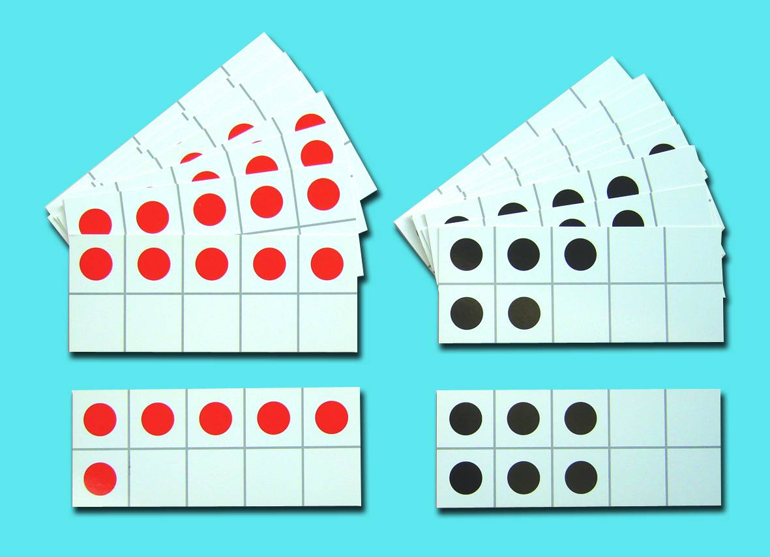
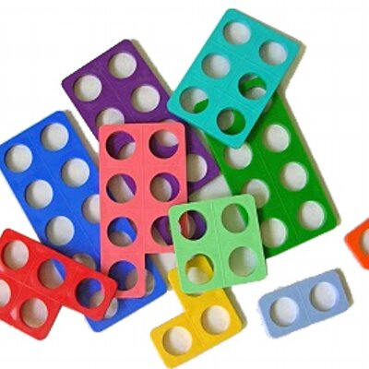
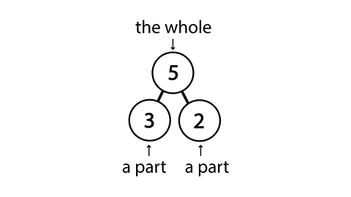
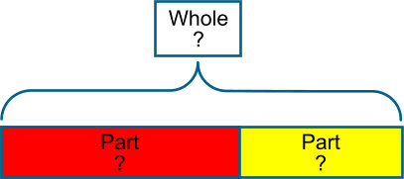
Concrete resources and pictorial representations
Base 10
Place Value Counters
Place Value Chart
Tens Frames
Numicon

Slide 9
Mastery-what’s that?
Having mastery in a maths topic means that children not only understand how to work out problems, but can also explain how they worked it out and apply their knowledge to more complicated word problems and investigations.
The core of White Rose Maths is the maths mastery approach, which focuses on depth rather than acceleration, ensuring that key concepts are fully grasped before moving on.
White Rose Maths emphasizes understanding over rote learning.

Slide 10
Support your child at home…
White Rose has an excellent selection of home learning resources that maybe useful to support your child at home.
https://whiteroseeducation.com/parent-pupil-resources/maths/home-learning

Slide 11

Further support for parents…
Maths with Michael-videos and guides for each topic
Primary Maths Dictionary
A very useful guide to all the maths terminology used in primary school.
See handout.
https://whiteroseeducation.com/parent-pupil-resources/maths/maths-with-michael

